Slide 1
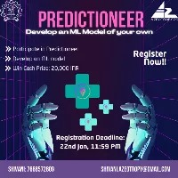
PREDICTI NEER
DETAILS OF TEAMS AND PROBLEM STATEMENT
Problem statement: Ebola Virus Predictioneer Module
Team Name: OP CODERS
Member 1: Anubhab Rakshit (Jadavpur University)
Member 2 : Srijit Das (Dayananda Sagar College of Engineering)
Member 3 : Shankhanil Saha (Dayananda Sagar College of Engineering)
Member 4 : Aditya Shome (Dayanand Sagar College of Engineering)
Team Leader Email : anubhabrakshit.06@gmail.com

Slide 2
AI-NE-BOLA
Ebola Virus Predictioneer

Slide 3
IDEA/APPROACH DETAILS
AI NE BOLA is an AI-powered module designed to analyze real-time data, plot outbreak trends, and predict potential Ebola spread using machine learning techniques
KEY FEATURES :-
Graph Plotting of Ebola Spread
Real-time Data Analysis
AI-based Predictions
Insights for Risk Assessment
FUNCTIONING :-
Collects data from an external datasheet.
Performs analysis using statistical and machine.
Earning models Generates predictions on Ebola virus spread trends.
Visualizes data through dynamic graphs.
DATA ANALYSIS:-
Obtain real time data about temperature and Humidity for enhanced prediction accuracy.
KNN Algorithm
Inverse distance weighted algorithm

Slide 4
IDEA/APPROACH DETAILS
NEXT STEPS :-
Enhancing AI models for higher prediction accuracy
Integrating real-time API data sources
Expanding to other epidemic predictions
Improving visualization tools for better user experience

Slide 5
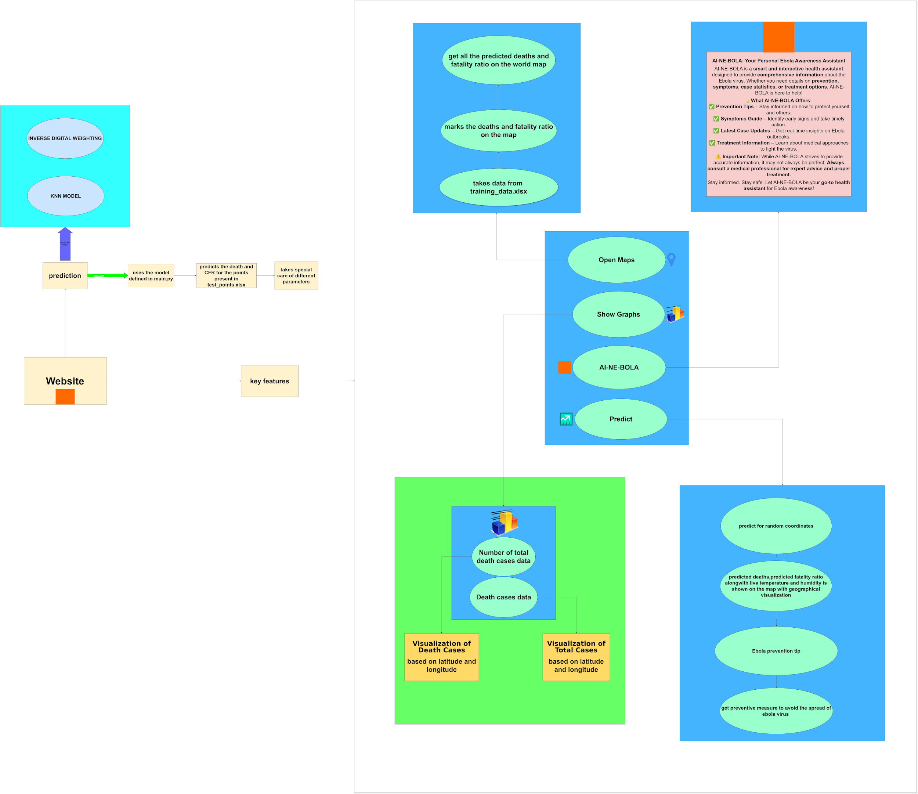
Flowchart

Slide 6
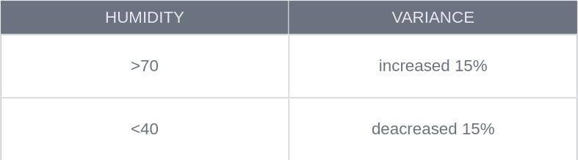
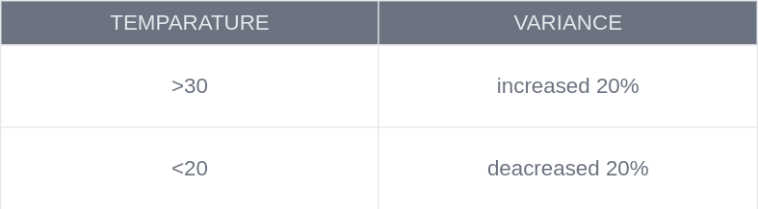
TEMPERATURE AND HUMIDITY DEPENDANCE

Slide 7
ALGORITHMS USED
KNN Algorithm -
The K-Nearest Neighbors (KNN) algorithm is a supervised learning method used for classification and regression. It works by finding the 'K' closest data points to a query point and making predictions based on their majority class (classification) or average value (regression).
How It Works:
Choose K (number of neighbors).
Calculate distances (e.g., Euclidean distance) between the query point and all training points.
Select the K nearest neighbors.
Predict the class (majority vote) or value (average) of these neighbors.

Slide 8
ALGORITHMS USED
INVERSE DISTANCE WEIGHTED ALGORITHM -
The Inverse Distance Weighted (IDW) algorithm is an interpolation method used in spatial analysis. It predicts values at unknown points based on nearby known points, giving more weight to closer points.
How It Works:
Assigns weights inversely proportional to the distance (e.g., 1/distance²).
Closer points influence predictions more than distant ones.
Used in geospatial mapping, weather prediction, and terrain modeling.

Slide 9





TECH STACK
ML Algorithms -
Used to implement ml algorithms like KNN,Inverse distance,etc
Data Visualisation-
For Graphical representation
For Calculations-
Using arrays,percentage increment decrement, etc
Handling Data -
Managing excel sheets
Data Analysis -
Obtaining Data for ML algorithms

Slide 10
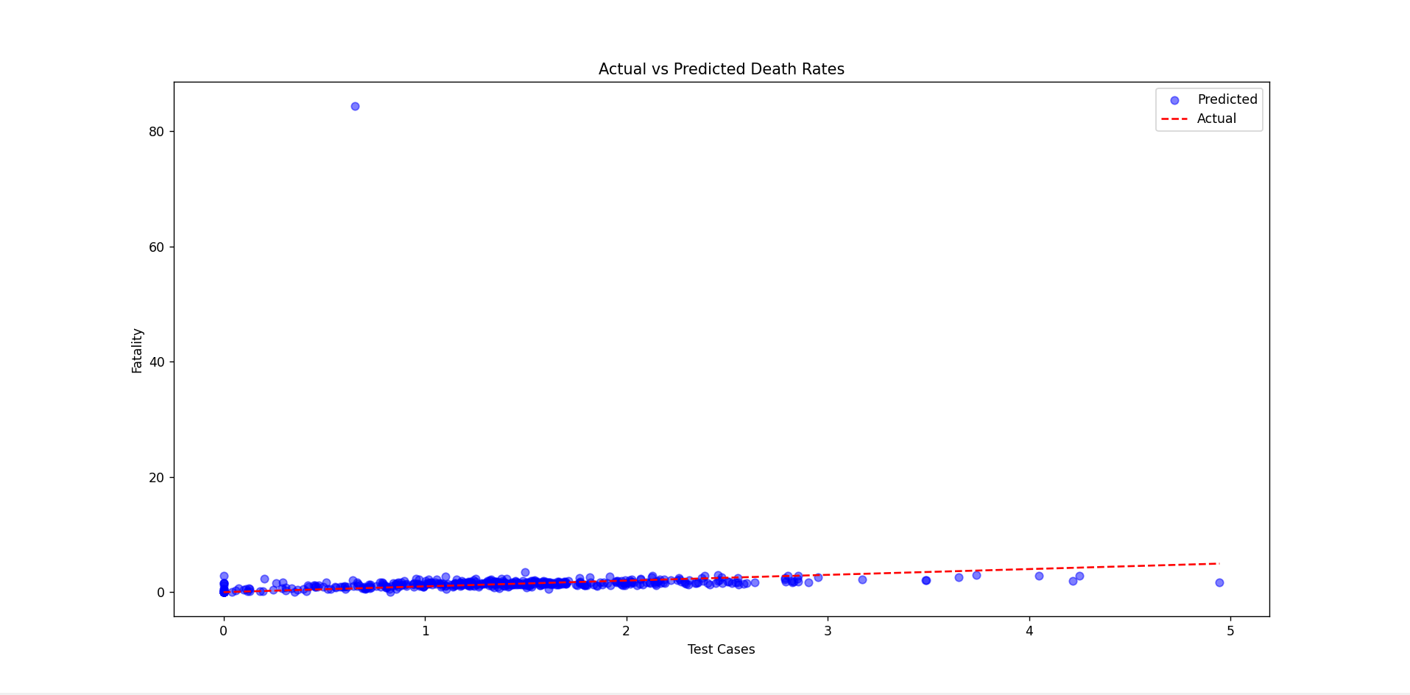
MEAN SQUARED ERROR IN DEATHS USING IDW METHOD
3.87699917065292
MEAN ABSOLUTE ERROR IN DEATHS USING IDW METHOD
0.5779446969324394

Slide 11
MODEL OVERVIEW
MSE FOR DEATHS
2006.95555
Values of errors are more , as it takes into account the real time live data
MSE FOR CFR
0.2389
ABSOLUTE ERROR FOR DEATHS
74998.23106
ABSOLUTE ERROR FOR CFR
769.439

Slide 12
USE CASE
Helps raise awareness about Ebola virus
The Ebola Virus Predictioneer provides real-time outbreak insights, helping visualize trends and raise awareness of its spread.
Assists researchers and health officials in tracking outbreak trends
Our AI tool analyzes outbreak patterns using real-time and historical data, helping researchers track the virus and assess its spread.
Provides predictive insights for proactive decision-making
The module uses machine learning to predict Ebola hotspots, helping authorities take early action and improve response planning.

Slide 13
DEPENDENCIES / SHOWSTOPPER FOR "EBOLA PREDICTIONEER"
AI-Powered Prediction: A machine learning model that forecasts Ebola outbreak trends based on real-time and historical data.
Real-Time Data Integration: Collects live data from external sources to ensure up-to-date outbreak tracking and risk assessment.
Accessible Analytics: User-friendly dashboards , making data interpretation easier for global health organizations.
Data-Driven Decision Making: Advanced visualization tools reveal outbreak patterns, improving strategic planning and response efforts.
Geological Visualisation: View of world map with markers about outbreaks.
AI Chatbot: Our chatbot AI-Ne-Bola is there to assist users with requirements and Queries related to any sort of topics about Ebola Virus.

Slide 14
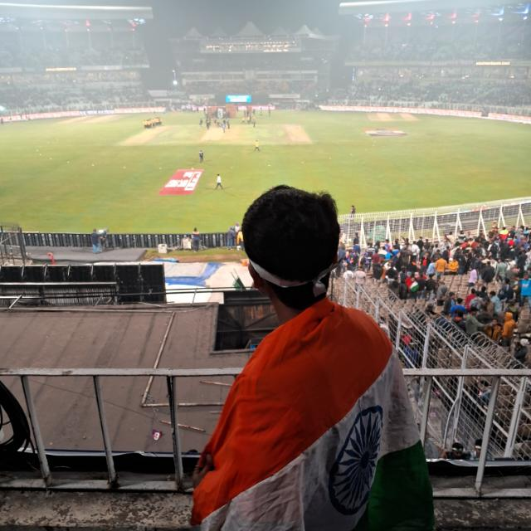



TEAM MEMBER DETAILS
ANUBHAB RAKSHIT
Mail :- anubhabrakshit.06@gmail.com
SHANKHANIL SAHA
Mail : shankhanilsaha@gmail.com
SRIJIT DAS
Mail : srijitd248@gmail.com
ADITYA SHOME
Mail: aditya737368@gmail.com

